Slide 1
Compositional Design Principles
The “GoF” principles
Or
Principles of Flexible Design
CS, AU
Henrik Bærbak Christensen

Slide 2
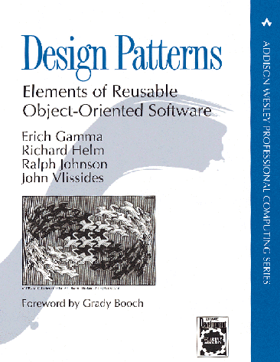
Gang of Four (GoF)
Erich Gamma, Richard Helm
Ralph Johnson & John Vlissides
Design Patterns – Elements of
Reusable Object-Oriented Software
Addison-Wesley, 1995.
(As CD, 1998)
First systematic software pattern description.
CS, AU
Henrik Bærbak Christensen

Slide 3
The most important chapter
Section 1.6 of GoF has a section called:
How design patterns solve design problems
This section is the gold nugget section
It ties the patterns to the underlying coding principles that delivers the real power.
CS, AU
Henrik Bærbak Christensen

Slide 4
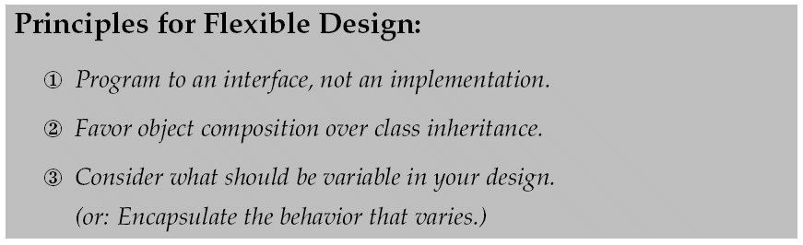
Compositional Design Principles
CS, AU
Henrik Bærbak Christensen

Slide 5
First Principle
CS, AU
Henrik Bærbak Christensen

Slide 6
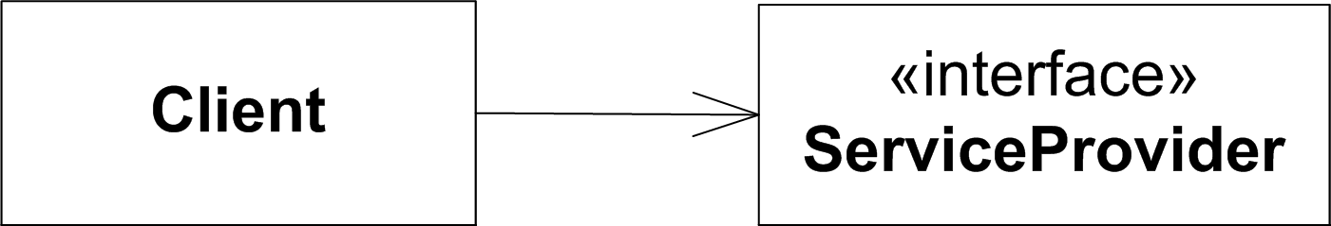
GoF’s 1st principle
Program to an interface, not an implementation
In other words
Assume only the contract
(the responsibilities)
… and never allow yourself to be coupled to implementation details and concrete behaviour
CS, AU
Henrik Bærbak Christensen

Slide 7
First Principle
Program to an interface because
  You are free to use any service provider class!
  You do not delimit other developers for providing their service provider class!
  You avoid binding others to a particular inheritance hierarchy
    Which you would do if you use (abstract) classes…

Slide 8
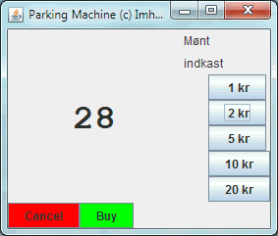


Example
Early pay station GUI used JPanel for visual output
I only use method: ’setText’
CS, AU
Henrik Bærbak Christensen
Notes:
I found this GUI in sa-E05

Slide 9
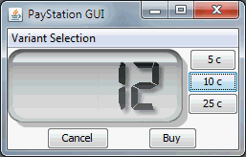

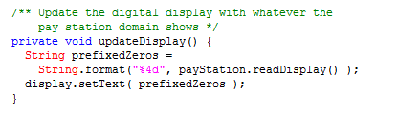
Example
The I found SoftCollection’s number display, got permission to use it, but...
... And use:
CS, AU
Henrik Bærbak Christensen

Slide 10
Morale
I would have been easy to make the code completely identical, and thus support full reuse, in which I simply configure PayStationGUI with the proper ’text panel’ to use.
But I cannot!
  Because LCDDigitDisplay does not inherit JPanel!!!
Thus instead of dependency injection and change by addition I get
Change by modification
  I have to start eclipse just to change one declaration!
  I can never get a framework out of this!
CS, AU
Henrik Bærbak Christensen

Slide 11
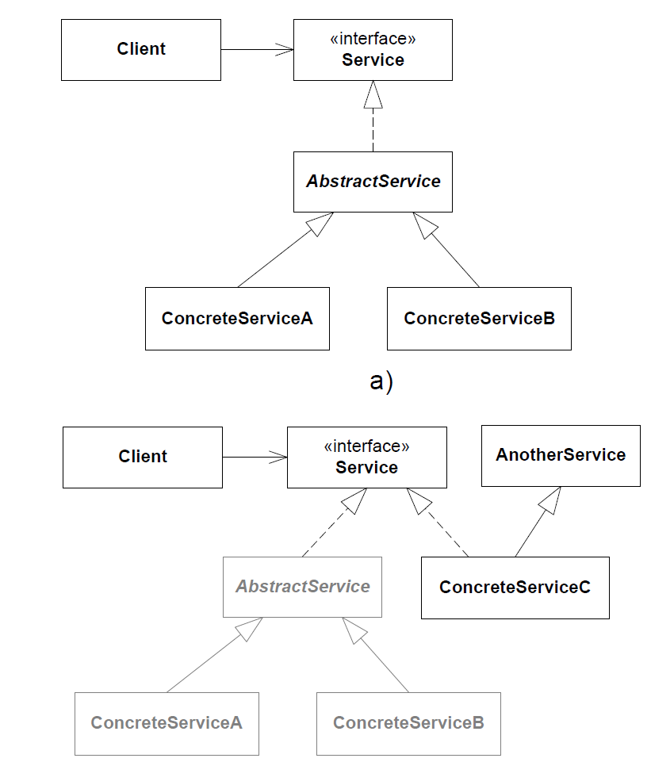
If JPanel was an interface instead!
  setText(String s);
Then there would be no hard coupling to a specific inheritance hierarchy.
GUI
IJPanel
JPanel
LCDDigitDisplay
CS, AU
Henrik Bærbak Christensen

Slide 12
Interfaces allow fine-grained behavioural abstractions
Clients can be very specific about the exact responsibility it requires from its service provider
Example:
  Collections.sort( List l )
  can sort a list of any type of object if each object implements the interface Comparable
  i.e. must implement method CompareTo(Object o)
Low coupling – no irrelevant method dependency!
CS, AU
Henrik Bærbak Christensen

Slide 13
Interfaces better express roles
Interfaces express specific responsibilities whereas classes express concepts. Concepts usually include more responsibilities and they become broader!
Small, very well defined, roles are easier to reuse as you do not get all the “stuff you do not need...”
public interface Drawing
extends SelectionHandler,
FigureChangeListener,
DrawingChangeListenerHandler { ... }
public class StandardSelectionHandler implements SelectionHandler {...}
CS, AU
Henrik Bærbak Christensen

Slide 14
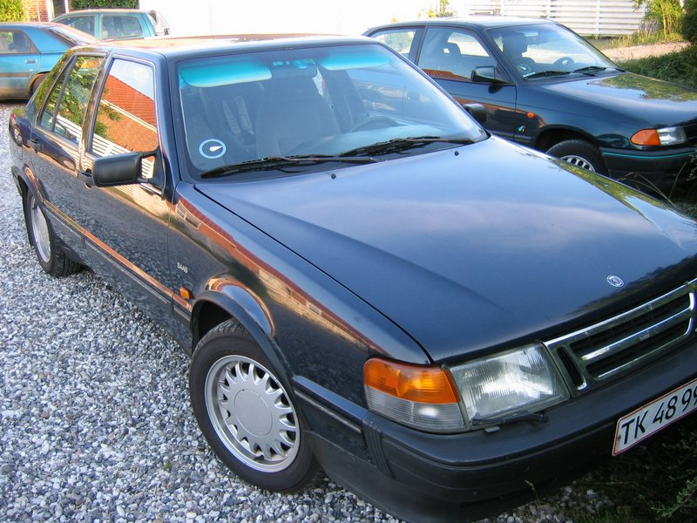
Umbrella responsibility
class Car extends Umbrella ?
class Umbrella extends Car ?
class Car implements UmbrellaRole
NONSENSE!
Sensible
CS, AU
Henrik Bærbak Christensen
Henrik Bærbak Christensen

Slide 15
Second Principle
CS, AU
Henrik Bærbak Christensen

Slide 16
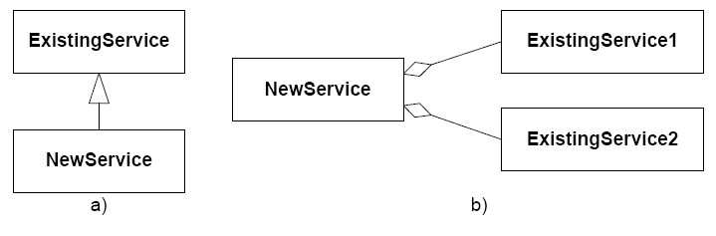
GoF’s 2nd principle
Favor object composition over class inheritance
What this statement says is that there are basically two ways to reuse code in OO
CS, AU
Henrik Bærbak Christensen

Slide 17
Analysis
Class inheritance
  You get the “whole packet” and “tweak a bit” by overriding a single or few methods
    Fast and easy (very little typing!)
    Explicit in the code, supported by language
      (you can directly write “extends”)
But...
CS, AU
Henrik Bærbak Christensen

Slide 18
Encapsulation
“inheritance breaks encapsulation”
Snyder 1986
CS, AU
Henrik Bærbak Christensen

Slide 19
Why?
No encapsulation because
  Subclass can access every
    instance variable/property
    data structure
    Method
  Of any superclass (except those declared private)
Thus a subclass and superclass are tightly coupled
  You cannot change the root class’ data structure without refactoring every subclass in the complete hierarchy ☹
CS, AU
Henrik Bærbak Christensen

Slide 20
Only add responsibilities, never remove
You buy the full package!
  All methods, all data structures
  Even those that are irrelevant or down right wrong!
Example (Early Java)
  Java.util.Stack extends java.util.Vector (ArrayList)
    A stack should only support push and pop
    But it of course also support addAt(i) and remove(j)
Exercise:
  What is the proper compositional relation between a stack and an ArrayList?
CS, AU
Henrik Bærbak Christensen

Slide 21
Compile time binding
The only way to change behaviour in the future (tweak a bit more) is through the edit-compile-debug-debug-debug-debug cycle
CS, AU
Henrik Bærbak Christensen

Slide 22
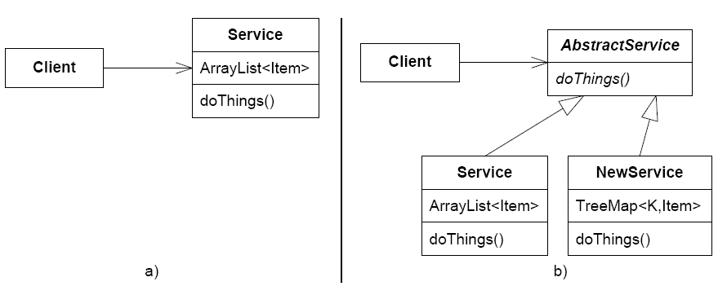
Recurring modifications
Constantly bubling of behaviour up into the root class in a hierarchy
  Review the analysis in the State pattern chapter
Another example
  Nice service based upon ArrayList
    Now – want better performance in new variant
  All three classes
  modified ☹
CS, AU
Henrik Bærbak Christensen

Slide 23
Separate Testing
Often, small and well focused abstractions are easier to test than large classes
  However, often requires test stubs
CS, AU
Henrik Bærbak Christensen

Slide 24
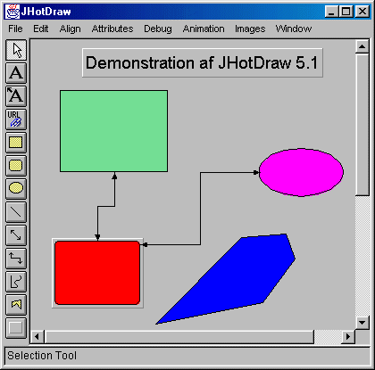
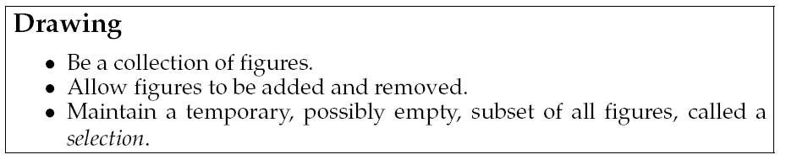
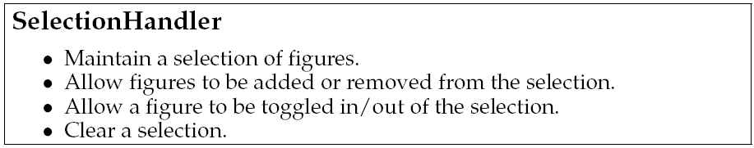
Increase possibility of reuse
Smaller abstractions are easier to reuse
Example (from MiniDraw)
  Sub responsibility
Allow compositional reuse of selection handler in all present and future impl. of Drawing!
CS, AU
Henrik Bærbak Christensen

Slide 25

Liabilities
Increased number of abstractions and objects ☹
Delegation requires more boiler-plate code ☹
CS, AU
Henrik Bærbak Christensen

Slide 26
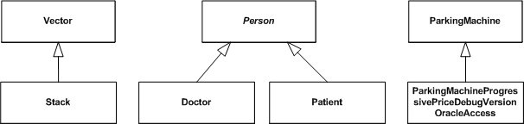
(what is he saying???)
Inheritance is OK but you must use it for what it handles really nice
  Modelling of concepts in a generalisation hierarchy
NOT for handling
  ad hoc reuse
  modelling roles
  variance of behaviour
CS, AU
Henrik Bærbak Christensen

Slide 27
Exercise
How does the three X designs on the former slide look if I apply the 2nd principle?
CS, AU
Henrik Bærbak Christensen

Slide 28
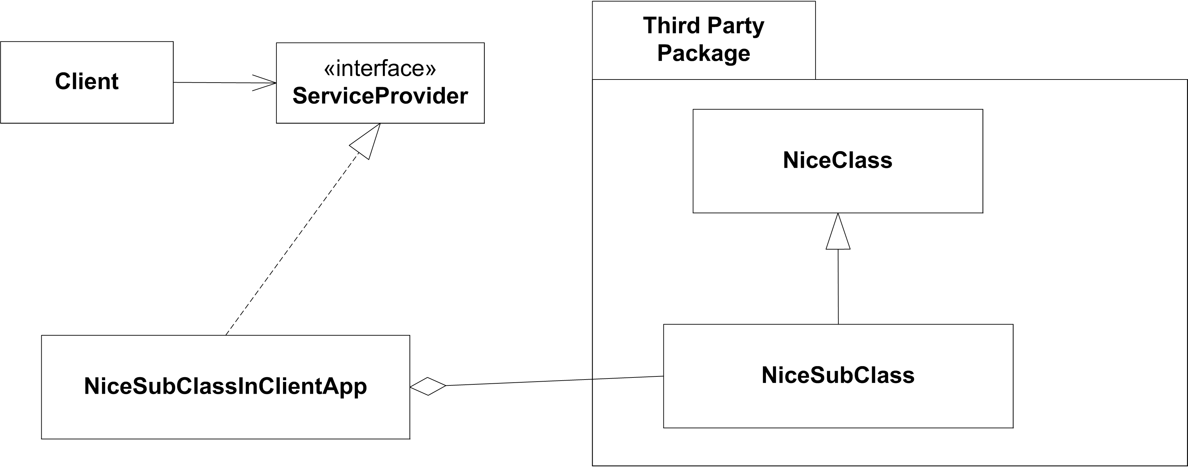
Exercise
Combining principle 1 and 2
  Combining behaviour from own subclass and third party class
It is also a design pattern!
  which one?
CS, AU
Henrik Bærbak Christensen

Slide 29
Third Principle
CS, AU
Henrik Bærbak Christensen

Slide 30
GoF’s 3rd principle
Consider what should be variable in your design
[GoF §1.8, p.29]
This approach is the opposite of focusing on the causes of redesign. Instead of considering what might force a change to a design, consider what you want to be able to change without redesign. The focus here is on encapsulating the concept that varies, a theme of many design patterns.
CS, AU
Henrik Bærbak Christensen

Slide 31
Alternative formulation
Another way of expressing the 3rd principle:
Encapsulate the behaviour that varies
CS, AU
Henrik Bærbak Christensen

Slide 32
Analysis
This statement is closely linked to the shorter
Change by addition, not by modification
That is – you identify
  the design/code that should remain stable
  the design/code that may vary
and use techniques that ensure that the stable part – well – remain stable
These techniques are 1st and 2nd principle
  most of the time ☺
CS, AU
Henrik Bærbak Christensen

Slide 33
Example
The pay station
  new price model???
    maybe this will vary in the future
  new receipt types ???
    maybe ...
  new display output ???
  testing often force detailed control...
CS, AU
Henrik Bærbak Christensen

Slide 34
The principles in action
CS, AU
Henrik Bærbak Christensen

Slide 35
Principles in action
Applying the principles lead to basically the same structure of most patterns:
  New requirement to our client code
Client
CS, AU
Henrik Bærbak Christensen

Slide 36
Principles in action
Applying the principles lead to basically the same structure of most patterns:
③ Consider what should be variable
Client
Variability
CS, AU
Henrik Bærbak Christensen

Slide 37
Principles in action
Applying the principles lead to basically the same structure of most patterns:
① Program to an interface
Client
«interface»
Variability
CS, AU
Henrik Bærbak Christensen

Slide 38
Principles in action
Applying the principles lead to basically the same structure of most patterns:
② Favour object composition
Client
«interface»
Variability
ConcreteVariation1
ConcreteVariation2
CS, AU
Henrik Bærbak Christensen

Slide 39
Summary
③ We identified some behaviour that was likely to change…
① We stated a well defined responsibility that covers this behaviour and expressed it in an interface
② Instead of performing behaviour ourselves we delegated to an object implementing the interface
③ Consider what should be variable in your design
① Program to an interface, not an implementation
② Favor object composition over class inheritance
CS, AU
Henrik Bærbak Christensen

Slide 40
Consideration
Beware – it is not a process to follow blindly
  Often the key point is principle 2: look over how you may compose the resulting behavior most reasonable
  Examples
    Abstract Factory: We did not make a ReceiptIssuer specifically for receipts but found a more general concept
    Decorator + Proxy: Sometimes the ‘encapsulation of what varies’ can be the whole abstraction and the solution relies on composition of ‘large’ objects.
CS, AU
Henrik Bærbak Christensen

Slide 41
Summary
GoF list 23 patterns – but
they also list three principles that are essential...
... elements of reusable object-oriented software...
CS, AU
Henrik Bærbak Christensen

